Slide 1
ALJABAR LINIER
Dr. RETNO KUSUMANINGRUM, S.SI., M.Kom.
Matriks
~ Invers ~

Slide 2
Definition of Inverse
The inverse is Defined as AA⁻¹ = A⁻¹A = I
We will find out how to calculate the inverse for 2x2 matrix
But first why is it important ?
Because it will allow us to solve equations of the form
We will only consider 2x2 Matrix systems
That means simultaneous equations

Slide 3
Why will it help us solve equations?
Because if we can express a system of equations in the form
Then we can multiply both sides by the inverse matrix
And we can then know the values of X because

Slide 4
INVERS MATRIKS
Suatu matriks bujur sangkar A ordo n disebut singular bila det(A) = 0 dan non singular bila det(A) ≠ 0 → r(A) = n
Matriks bujur sangkar ordo n, singular bila r(A) < n
Matriks yasng non singular mempunyai invers dan yang singular tidak punya invers
Suatu matriks bujur sangkar A berordo n, mempunyai invers bila ada suatu matriks B sedemikian sehingga AB = BA = I_{n.}
  B disebut invers dari A, ditulis A⁻¹

Slide 5
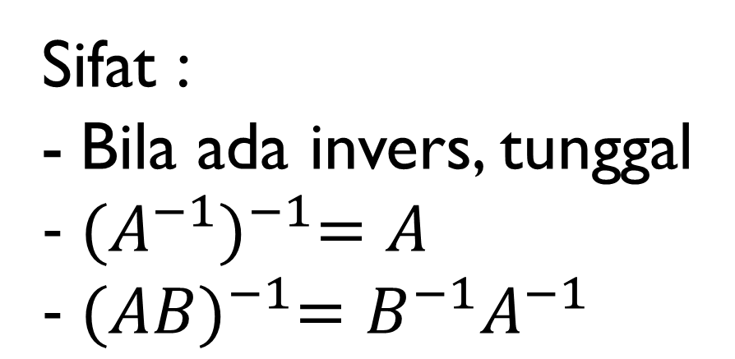
Sifat :
Bila ada invers, tunggal
${(A^{−1})}^{−1}=A$
${(AB)}^{−1}=B^{−1}A^{−1}$

Slide 6
The multiplicative inverse of a matrix
This can only be done with SQUARE matrices
By hand we will only do this for a 2x2 matrix
Inverses of larger square matrices can be calculated but can be quite time expensive for large matrices, computers are generally used
Ex A = then A⁻¹ = as AxA⁻¹ = I

Slide 7
Finding the Inverse of a 2x2 matrix (1)
Step-1 First find what is called the Determinant
This is calculated as ad-bc
Step-2 Then swap the elements in the leading diagonal
Step-3 Then negate the other elements
Step-4 Then multiply the Matrix by 1/determinant

Slide 8
Example Find Inverse of A
Step 1 – Calc Determinant
Determinant (ad-cb) = 4x3-8x1 = 4
Step 2 – Swap Elements on leading diagonal
Step 3 – negate the other elements
Step 4 – multiply by 1/determinant

Slide 9
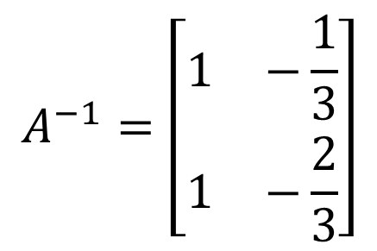

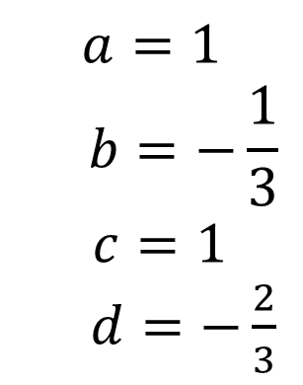
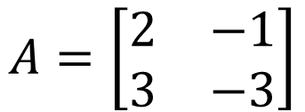
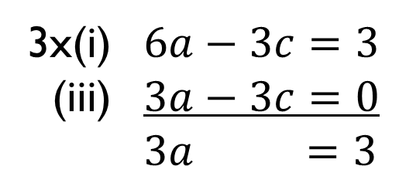
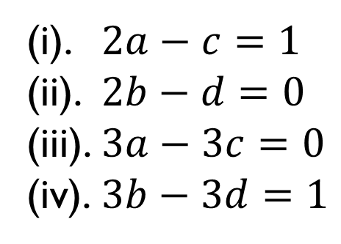

ANOTHER WAY:
$$A=\left[\begin{matrix}2 & −1 \\ 3 & −3\end{matrix}\right]$$
➔ $A^{−1}$
Misal $A^{−1}=\left[\begin{matrix}a & b \\ c & d\end{matrix}\right]$, maka : $\left[\begin{matrix}2 & −1 \\ 3 & −3\end{matrix}\right]\left[\begin{matrix}a & b \\ c & d\end{matrix}\right]=\left[\begin{matrix}1 & 0 \\ 0 & 1\end{matrix}\right]$
(i). $2a−c=1$
(ii). $2b−d=0$
(iii). $3a−3c=0$
(iv). $3b−3d=1$
➔
3x(i) $6a−3c=3$
(iii) $3a−3c=0$
$3a =3$
$$a=1$$
$$b=−\frac{1}{3}$$
$c=1$
$d=−\frac{2}{3}$
$$A^{−1}=\left[\begin{matrix}1 & −\frac{1}{3} \\ 1 & −\frac{2}{3}\end{matrix}\right]$$
➔

Slide 10
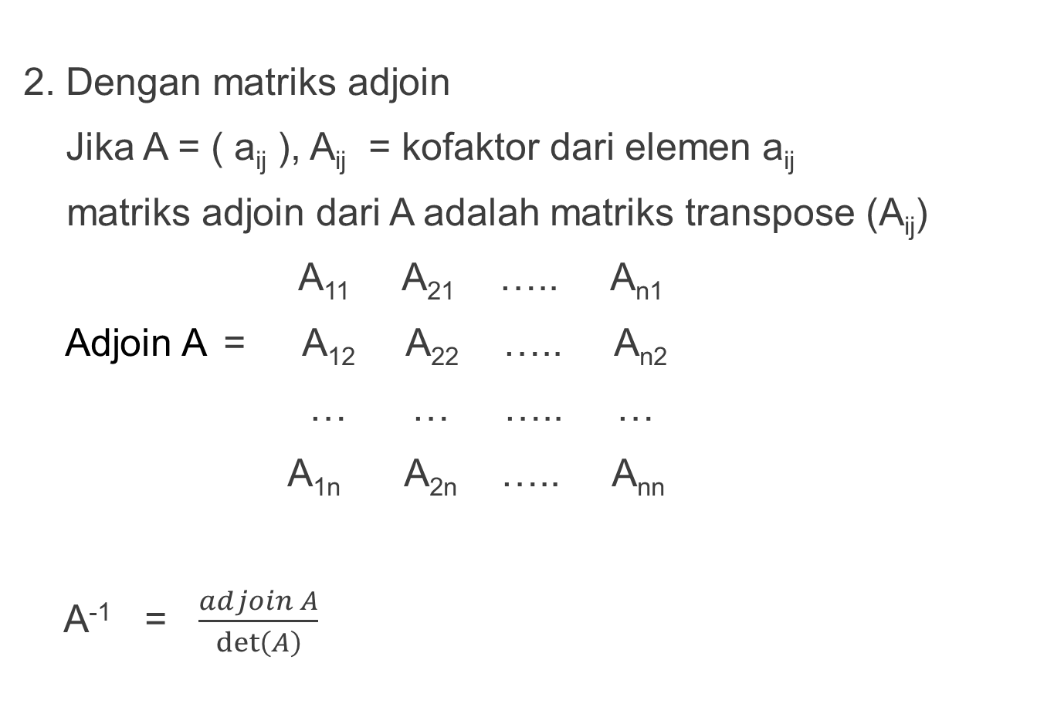
2. Dengan matriks adjoin
Jika A = ( a_{ij} ), A_{ij} = kofaktor dari elemen a_{ij}
matriks adjoin dari A adalah matriks transpose (A_{ij})
A₁₁ A₂₁ ….. A_{n1}
Adjoin A = A₁₂ A₂₂ ….. A_{n2}
… … ….. …
A_{1n} A_{2n} ….. A_{nn}
A⁻¹ = $\frac{adjoin A}{\det\left(A\right)}$

Slide 11
3. Dengan transf elementer
Dengan mencari matriks bujur sangkar P dan Q sedemikian sehingga PAQ = I_{n}
P didapat dengan sederetan transf elementer baris, Q didapat dengan sederetan transf elementer kolom terhadap I_{n}
P : Tulis I dimuka A, jadikan nol elemen-elemen di bawah diagonal utama dengan transf elementer baris
Q : Tulis I dibawah matriks segi atas tersebut. Jadikan nol elemen-elemen diatas diagonal utama dengab transf. elementer kolom
PAQ = I
P⁻¹PAQQ⁻¹ = P⁻¹ I Q⁻¹
A = P⁻¹Q⁻¹ = (QP)⁻¹
A⁻¹ = QP

Slide 12
Contoh :
1 3 2
A = 1 4 6
2 5 7
1 0 0 1 -3 10
→ P = -1 1 0 Q = 0 1 -4
-3/7 1/7 1/7 0 0 1
-2/7 -11/7 10/7
A⁻¹ = 5/7 3/7 -4/7
-3/7 1/7 1/7

Slide 13
1 0 0 1 3 2 H₂₁₍₋₁₎ 1 0 0 1 3 2 H32(1)
0 1 0 1 4 6 ∼ -1 1 0 0 1 4 ∼
0 0 1 2 5 7 H₃₁₍₋₂₎ -2 0 1 0 -1 3
1 0 0 1 3 2 H_{3(1/7)} 1 0 0 1 3 2
-1 1 0 0 1 4 ∼ -1 1 0 0 1 4
-3 1 1 0 0 7 -3/7 1/7 1/7 0 0 1
P

Slide 14




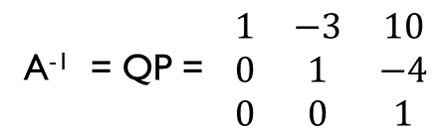

$$\frac{\begin{matrix}1 & 3 & 2 \\ 0 & 1 & 4 \\ 0 & 0 & 1\end{matrix}}{\begin{matrix}1 & 0 & 0 \\ 0 & 1 & 0 \\ 0 & 0 & 1\end{matrix}}$$
$$\frac{\begin{matrix}1 & 0 & 0 \\ 0 & 1 & 4 \\ 0 & 0 & 1\end{matrix}}{\begin{matrix}1 & −3 & −2 \\ 0 & 1 & 0 \\ 0 & 0 & 1\end{matrix}}$$
$$\frac{\begin{matrix}1 & 0 & 0 \\ 0 & 1 & 0 \\ 0 & 0 & 1\end{matrix}}{\begin{matrix}1 & −3 & 10 \\ 0 & 1 & −4 \\ 0 & 0 & 1\end{matrix}}$$
_{K21(-3)}
∼
_{K31(-2)}
_{K32(-4)}
∼
Q
A⁻¹ = QP = $\begin{matrix}1 & −3 & 10 \\ 0 & 1 & −4 \\ 0 & 0 & 1\end{matrix}$
$$\begin{matrix}1 & 0 & 0 \\ −1 & 1 & 0 \\ −3/7 & 1/7 & 1/7\end{matrix}$$
$$\begin{matrix}−2/7 & −11/7 & 10/7 \\ 5/7 & 3/7 & −4/7 \\ −3/7 & 1/7 & 1/7\end{matrix}$$
=

Slide 15
4. Metode Gauss-Jordan
Steps:
Set up the given matrix with the identity matrix as the form of “augmented matrix”
Transforming the left matrix into the identical matrix follow the rules of row operations

